Slide 1

Sustainability of pig production trough increased usage of local protein feeds
Rünno Patune
PRIA Meede 16.2

Slide 2

Meat advertisement ban

Slide 3

www.lihafoor.ee (Eestimaa Looduse Fond ja world wildlife)

Slide 4
Feeding trials in Tempo Põllumajandus OÜ Jussi pig farm
Dry feeding farm for 1024 pigs.
Possibility to feed 2 different formulas same time.
Pigs are divided to 4 groups:
Feed A, females
Feed A, males
Feed B, females
Feed B, males
The objectives of the trials:
Analyses of the amino acid composition and nutritional values of local feed materials
Optimization of feed rations for growers and finishers using maximum local raw materials
Testing feed rations when feeding pigs
Evaluation of economic and environmental results

Slide 5
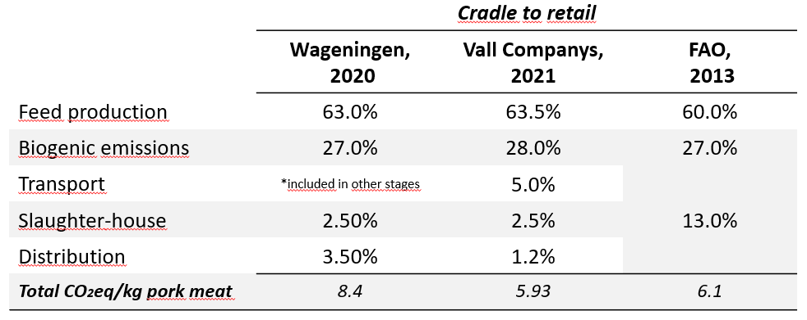
CO2 eqv emissions distribution of the stages to produce pork meat until the retail gate:

Slide 6
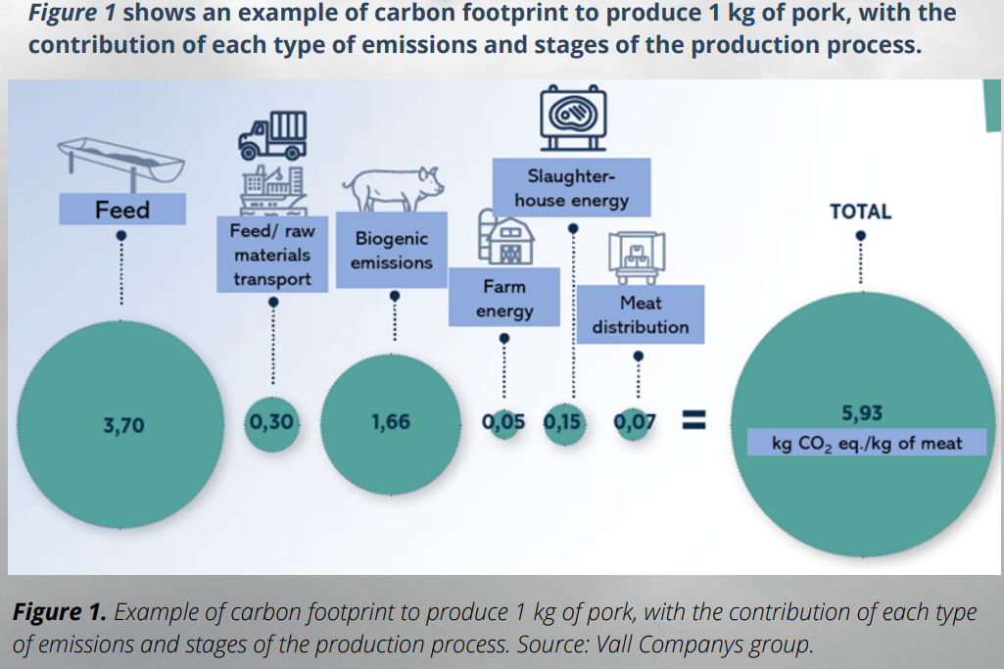
Carbon footprint to produce 1 kg of pork
.

Slide 7
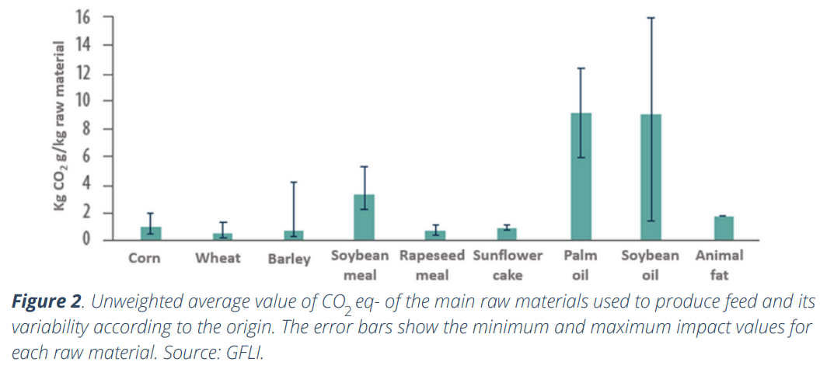
Raw materials Co2 eqv emissions
.

Slide 8
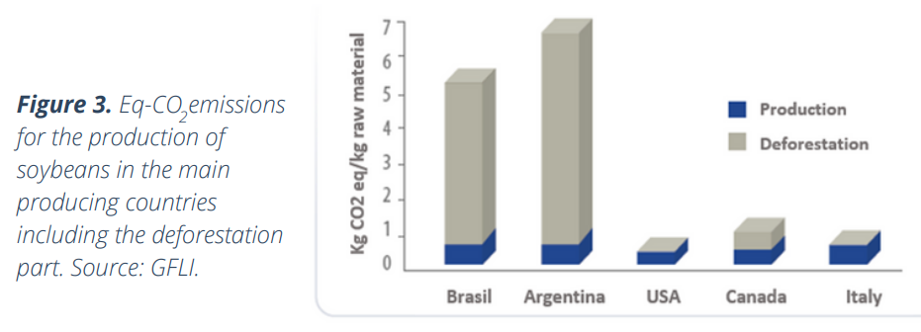
Soy CO2 eqv. emissions
.

Slide 9
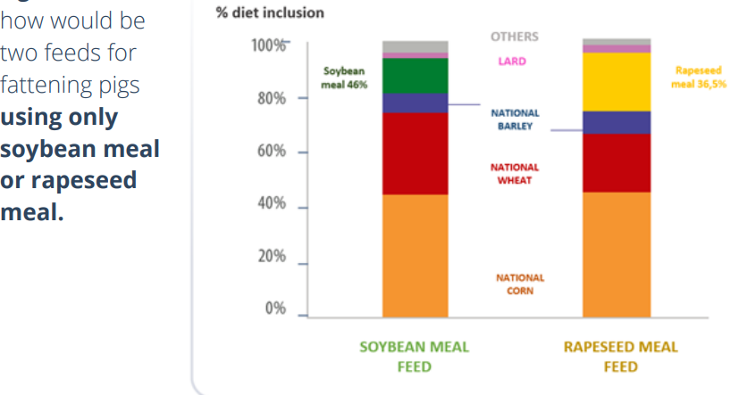
Soy vs rapeseed meal based diets

Slide 10
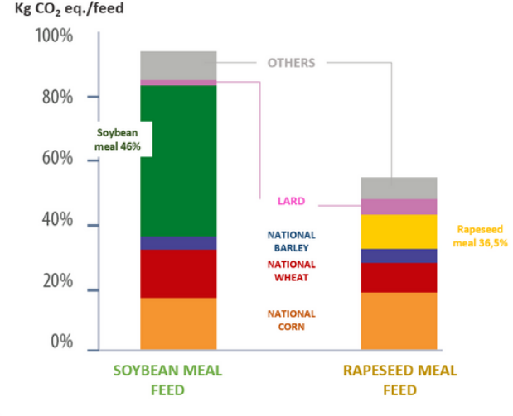
Soy vs rapeseed meal based diets CO2 eqv. Emissions comparison
.

Slide 11
CO2 eqv. emissions in trial diets (3.11.22-28.02.23)

Slide 12
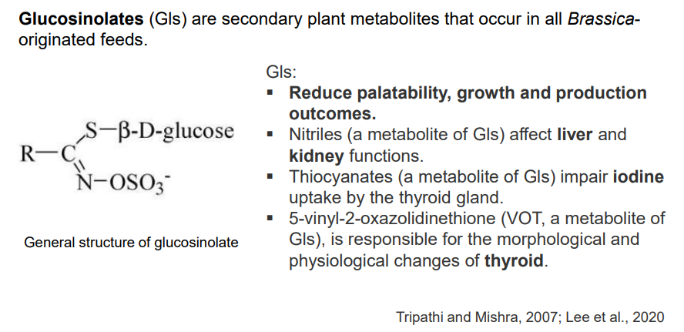
ANTI-NUTRITIONAL FACTORS of Rapeseed meal rapeseed meal level in no soy grower 2 was 18,07%

Slide 13
Formulas prices and protein levels %
 | Crude protein, % | Price, eur | Crude protein, % | Price, eur | Crude protein, % | Price, eur | Crude protein, % | Price, eur
 | Starter 2 |  | Grower1 |  | Grower2 |  | Finisher
REGULAR formulas | 17.00 | 392.62 | 17.14 | 353.33 | 16.88 | 322.27 | 15.28 | 292.72
LOW/NO soya formulas | 15.67 | 463.18 | 16.29 | 347.36 | 15.35 | 314.84 | 13.42 | 292.54
Soya usage decrease per 1 pig in period 21,3- 111,8kg from 25 kg to 6,6 kg
Rapeseed usage increase per 1 pig in period 21,3- 111,8kg from 22,4 kg to 28,3 kg
Lean meat % was 59,7% in both feeding groups
.

Slide 14
Growth performance by treatment
Feed prices october 2022
 | All period | feed |  |  |  | kg |  | eur/pig | eur/pig/day
Average days |  | total kg | residue kg | usage kg | pigs | usage per pig | feed price eur/kg | feed price | feed price | increment kg | ADG gr/day | FCR | ADFI
105.0 | NO/LOW soya feed total | 139940 | 0 | 139940 | 485 | 288.5 | 0.408 | 117.6 | 1.12 | 91.4 | 870 | 3.2 | 2.75
106.0 | Regular feed total | 141460 | 0 | 141460 | 472 | 299.7 | 0.406 | 121.6 | 1.15 | 89.7 | 846 | 3.3 | 2.83
 |  | feed kg |  |  | feed kg |  |  | feed kg |  |  | feed kg
 | CO2 eqvivalent reduction | starter 2 | Co2 eqv | total | grower 1 kg | Co2 eqv | total | grower 2 | Co2 eqv | total | finisher | Co2 eqv | total | Total CO2 eqv kg | Co2 eqv per pig, kg
 | NO/LOW soya feed total | 12180 | 1.573 | 19159.14 | 18860 | 1.221 | 23028.06 | 12380 | 0.698 | 8641.24 | 96820.0 | 0.712 | 68935.8 | 119764 | 246.9
 | Regular feed total | 12200 | 1.705 | 20801 | 21220 | 1.473 | 31257.06 | 12080 | 1.241 | 14991.28 | 95960.0 | 0.949 | 91066.0 | 158115 | 335.0
 |  |  |  |  |  |  | Without soya and low prot feed compared with regular feed
 | average daily feed intake | ADFI |  |  |  |  | All period | -3.4 | % cheaper without consider growth speed
 | average daily gain | ADG |  |  |  |  |  | -35.7 | % lower CO2 eqv emission between body weight 21.3-111.8kg
 | feed conversion ratio | FCR |  |  |  |  |  | -1.0 | days, growth period

Slide 15
Grower 1 formulas
Feed prices March 2023
GROWER 1 |  | (28-45kg) |  |  | GROWER 1 |  | (28-45kg)
REGULAR FORMULA | price eur/t | kg | Price, eur |  | NO SOYA FORMULA | price eur/t | kg | Price, eur
SODIUM-BICARBONATE | 500.00 | 0.30 | 1.5 |  | q-ColMax | 6500.00 | 0.10 | 6.5
molasses | 245.00 | 1.50 | 3.7 |  | molasses | 245.00 | 1.00 | 2.5
triticale | 245.00 | 10.00 | 24.5 |  | rye | 230.00 | 7.7 | 17.7
wheat | 260.00 | 25.85 | 67.2 |  | wheat 11 CP | 260.00 | 50.00 | 130.0
barley | 245.00 | 36.41 | 89.2 |  | barley 10.3 CP | 245.00 | 10.00 | 24.5
rapeseed cake 31% protein | 375.00 | 7.00 | 26.3 |  | rapeseed cake 31/10 | 375.00 | 26.39 | 99.0
soyameal 45,5% protein | 600.00 | 13.80 | 82.8 |  | soyameal 45,5 CP | 600.00 | 0.00 | 0.0
rapeseed oil | 1300.00 | 2.00 | 26.0 |  | rapeseed oil | 1300.00 | 2.10 | 27.3
limestone | 80.00 | 0.49 | 0.4 |  | limestone | 80.00 | 0.69 | 0.6
MCP | 1050.00 | 0.92 | 9.7 |  | MCP | 1050.00 | 0.42 | 4.4
salt NaCl | 149.00 | 0.30 | 0.4 |  | salt NaCl | 149.00 | 0.50 | 0.7
PG STARTER premix 1% | 1690.00 | 1.00 | 16.9 |  | Pig Fattening 0,25% | 7800.00 | 0.25 | 19.5
L-LYSINE-HCL 79% | 1600.00 | 0.27 | 4.3 |  | L-LYSINE-HCL 79% | 1600.00 | 0.61 | 9.8
METHIONIN 99% | 2600.00 | 0.03 | 0.8 |  | METHIONIN 99% | 2600.00 | 0.04 | 1.0
THREONIN 98% | 1800.00 | 0.13 | 2.3 |  | THREONIN 98% | 1800.00 | 0.20 | 3.6
TOTAL |  | 100.00 | 355.98 |  | TOTAL |  | 100.00 | 347.03
 |  | CP % | 17.14 |  |  |  | CP % | 16.39

Slide 16
Conclusions
Low carbon footprint diets with rapeseed meal as the main protein source at the growing-finishing period improve growth performance and economic costs results (-4,0 €/pig) compared to higher carbon footprint diets
Low carbon footprint feeding program reduces 35.7% the CO2 eqv emissions of pork meat production (period 21,3-111,8kg)
Low carbon footprint feeding program decrease soya usage in grower-finisher period per 1 pig 18,4kg and increase rapeseed usage per 1 pig 5,9kg
Low carbon footprint feeding program is similar price as soya based feeding program

