Slide 1
Many paths to adulthood. Young people in sparsely populated rural areas in Finland under pressure to leave or stay.
Kaisa Vehkalahti, Academy Research Fellow,
Jyväskylä University, History & Ethnology

Slide 2
Mobility imperative – global phenomenon for rural young people
Depopulation of rural areas global phenomenon
Contradictory images: western rural idyls vs. rural global south as a source of massmigration
In youth studies focus on urban youth cultures, rural young people seen as the ‘other’ – disadvantaged version of their urban peers. (Cuervo & Wyn 2012; Farrugia 2016).
Mobility imperative (Corbett 2007; Farrugia 2016): need to leave rural regions in search of education and/or employment recognized globally.
Finland: Depopulation, school closures and centralisation of services - recent economic recovery has not benefitted rural areas.

Slide 3
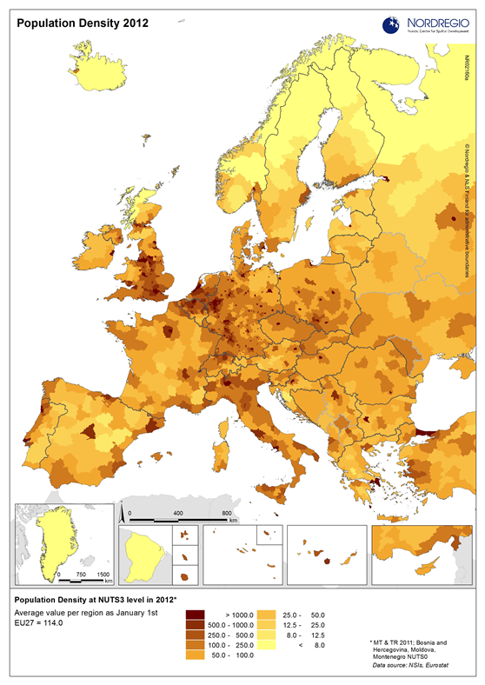
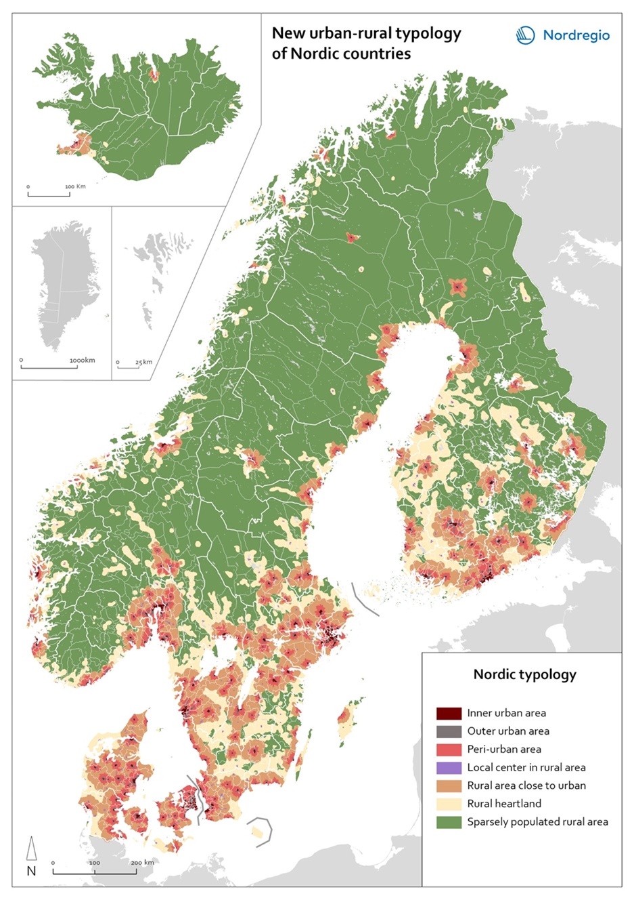
The Rural North
Nordic countries rank among most rural OECD countries in relation to population, area (proportion of rural areas more than 50%)
Nordic welfare states facing societal problems & future challenges in areas defined as rural:
Long trend of depopulation
Long distances, fragmented infrastructure
Withdrawal of services
Economical challenges
Ageing
School closures
Gender bias
Climate change

Slide 4
Finnish rural depopulation as a youth movement
1960s-1970s 'Great migration’
50% of baby boomers left rural areas in the, between the ages of 20–30
Northern- and Eastern Finland & Lapland lost population (emigration to Sweden, Southern cities)
Current trends:
Natural population growth (births-deaths) negative since 1980s in rural areas
Except rural areas close to bigger cities
Intramunicipal migration most important factor
Immigration to ”rural heartland areas” after 2000 due to refugee policy
Covid-18 pandemic change in migration patterns – only temporary?
Natural population growthNet migrationNet immigration
Source: Maaseutukatsaus 2017 (available on-line), review produced by the Finnish Rural Policy Council

Slide 5
"Rural exodus of young women" (Johansson 2016)
"Rural exodus of young women" in Swedish context (Mats Johansson 2016)
Why do young women leave?
Education: increasing level of education in the Scandinavian countries since 1990s
Gendered labour markets & lack of job opportunities for young women
Centralisation policy e.g. school closures and centralisation of services
Rural cultures of masculinity, small communities Local cultures of leaving
(Käyhkö & Armila 2021; Vehkalahti et al. 2021; Andersen et al. 2021)

Slide 6
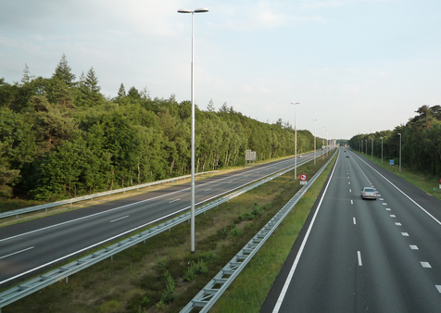
What do we mean by ‘staying’ and ‘leaving’?
Interview with a young couple, they talk about friends who have moved from the rural hometown (2022)
Interviewer: Yes. So quite a lot has changed [since the last interview]? Many of your friends – of both of you – have moved away?
Young man: Well, yeah, but most of them only temporarily, at least to my knowledge. Now ’Ville’ and ’Pekka’ are studying there in [a Nothern city], ’Eero’ in [a Southern city]. I don’t know. At least ’Ville’ is going to move back. That’s how it sounded to me when I asked.

Slide 7
Looking for the youth perspective!
How do young people in different parts of Finland navigate their way into adulthood?
Aim: to capture the back-and-forth movement that characterizes youth transitions (Cuervo & Wyn 2012; Holland 2011; Saldaña 2003), to map critical moments in young life (Thomson & Holland 2009)
Follow-up started on the last (9th) grade of compulsory education
Originally 125 young people (52% boys and 48% girls) from 5 diverse communities
Intended to continue for 10 years: follow up from age 15 to 25

Slide 8
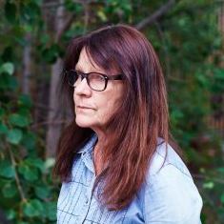
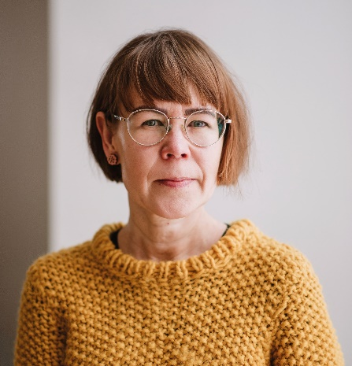
Helena Ristaniemi,
Indigenous studies:
Sámi homeland
(12 girls)
Kaisa Vehkalahti,
History:
Central Finland (15 young adults)
Päivi Armila,
Ville Pöysä, Mari Käyhkö,
Sociology:
Eastern Finland
(15 young adults)
Notes:
Urban-Rural classification by Finnish Environment Institute SYKE
1. Inner urban area: A compact and densely built area with continuous development.
2. Outer urban area: A dense urban area extending from the boundary of the inner urban area to the outer edge of the continuous built area.
3. Peri-urban area A part of the intermediate zone between urban and rural, which is directly linked to an urban area.
4. Local centres in rural areas Population centres located outside urban areas.
5. Rural areas close to urban areas Areas with a rural character that are functionally connected and close to urban areas.
6. Rural heartland areas Rural areas with intensive land use, with a relatively dense population and a diverse economic structure at the local level.
7. Sparsely populated rural areas Sparsely populated areas with dispersed small settlements that are located at a distance from each other. Most of the land areas are forested.

Slide 9
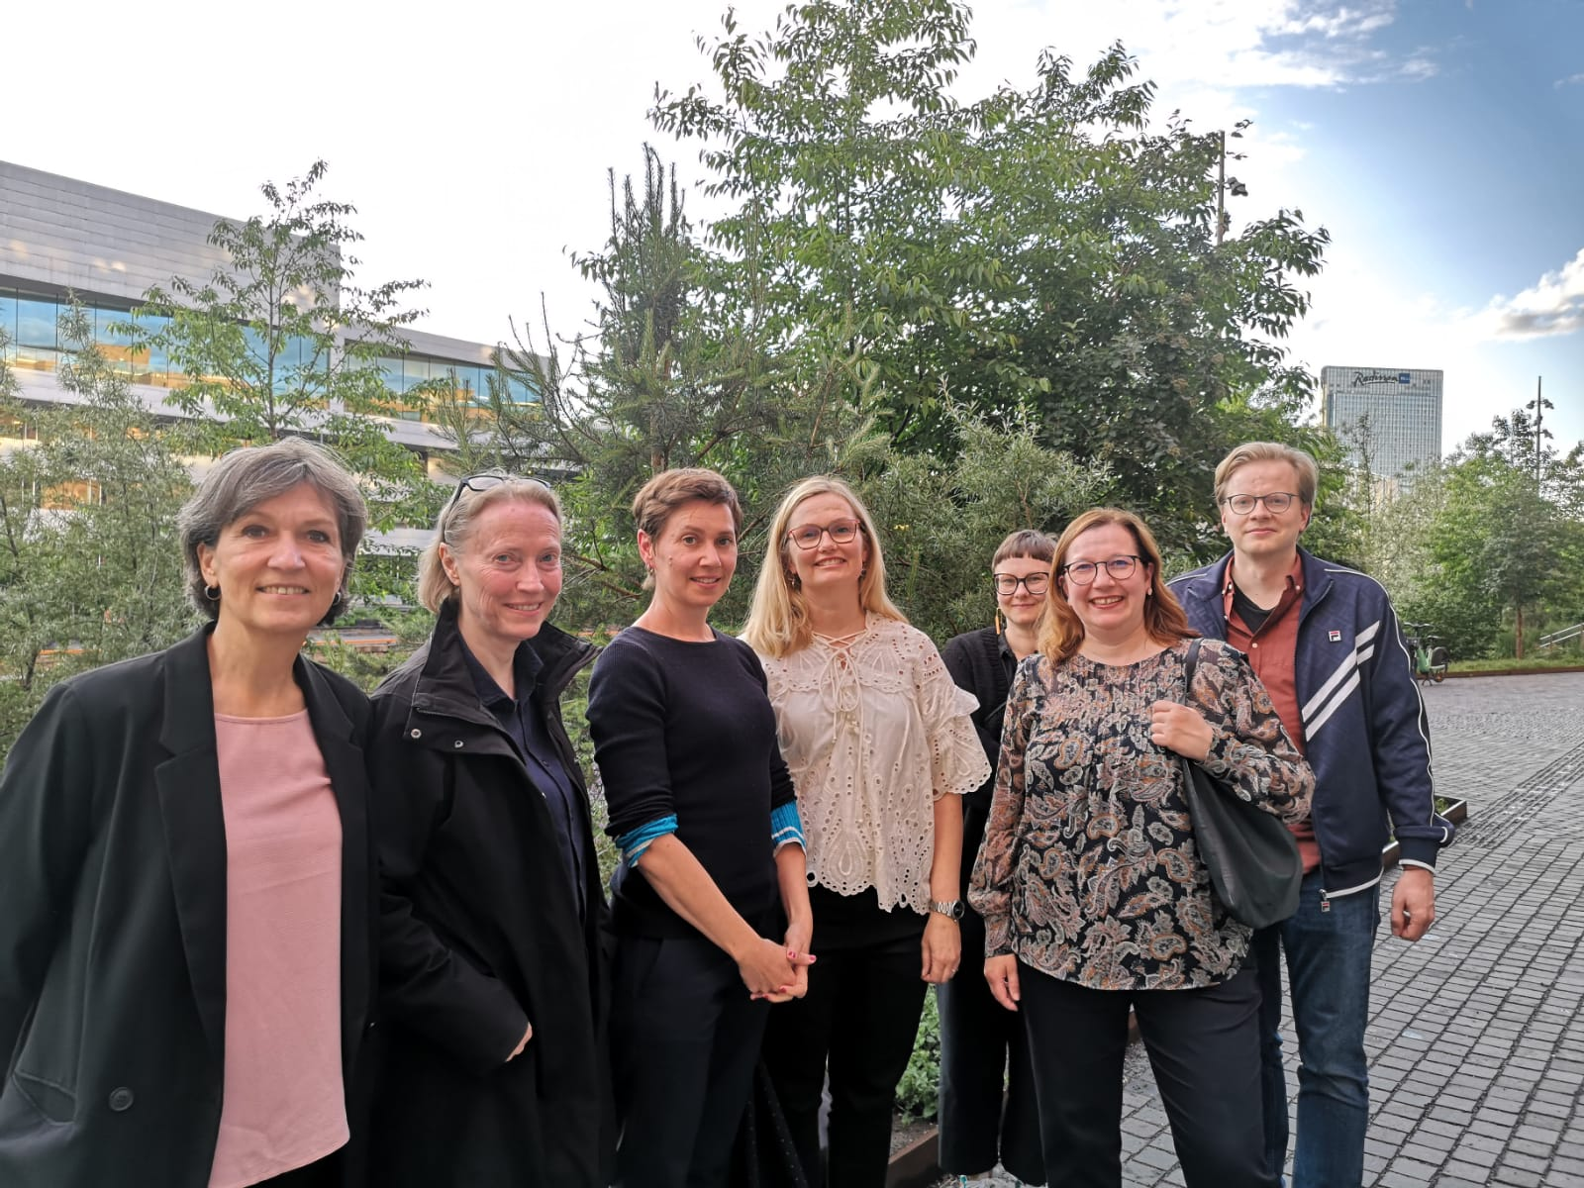
The Future of Nordic Youth in Rural Regions: A Cross-national Qualitative Longitudinal Study in four Nordic Countries (2022–2026)
Consortium
University of Jyväskylä: Kaisa Vehkalahti (PI),
University of Umeå, Sweden: Prof. Maria Rönnlund, Associate Prof. Aina Tollefsen
VIVE Danish Center for Social Science Research: Senior Researcher Jeanette Østergaard)
Oslo Metropolitan University, Norway: Senior Researcher Ingunn Marie Eriksen
Collaboration of four on-going qualitative follow-ups
Re-analysis of data
10 diverse regions
196 young people / young adults (born 1998–2005)

Slide 10
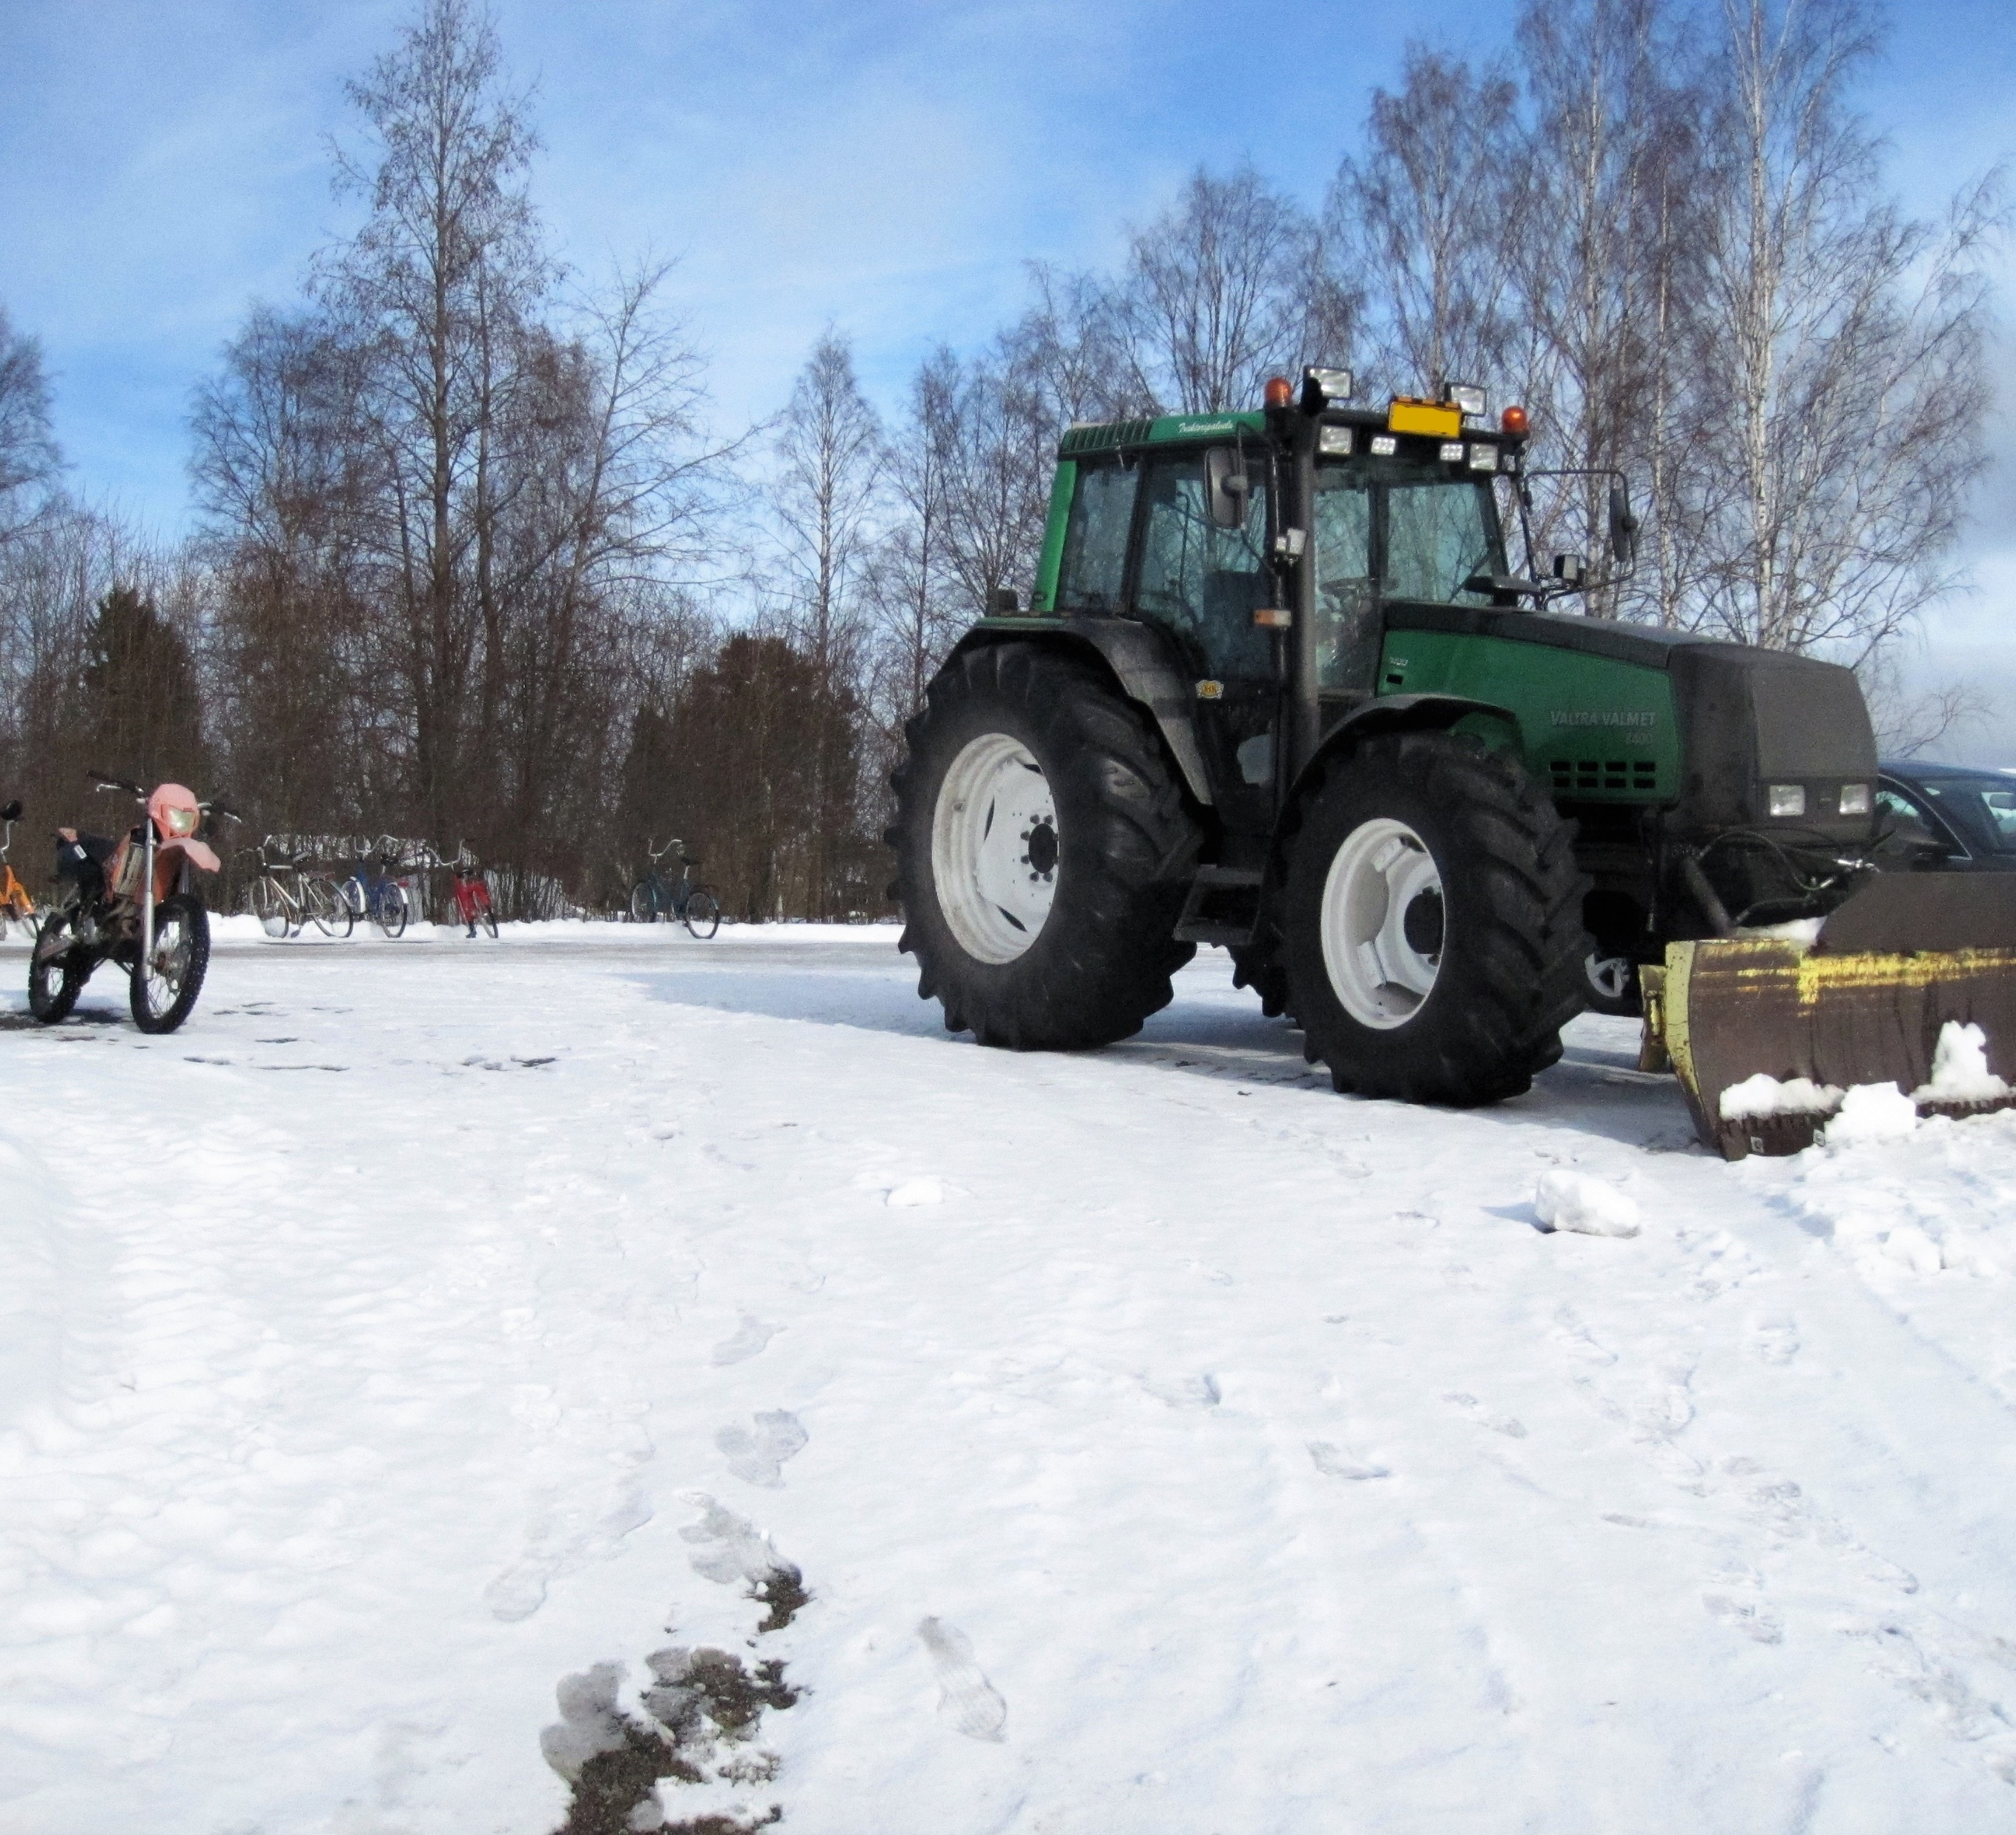
Central Finland
Population less than 5000
3 parallel classes at high school
Villages, distance to town center 40 km at most
Most elementary schools closed from villages
Upper secondary school (gymnasium) in the town center – no vocational options
20% employed in agriculture and forestry

Slide 11
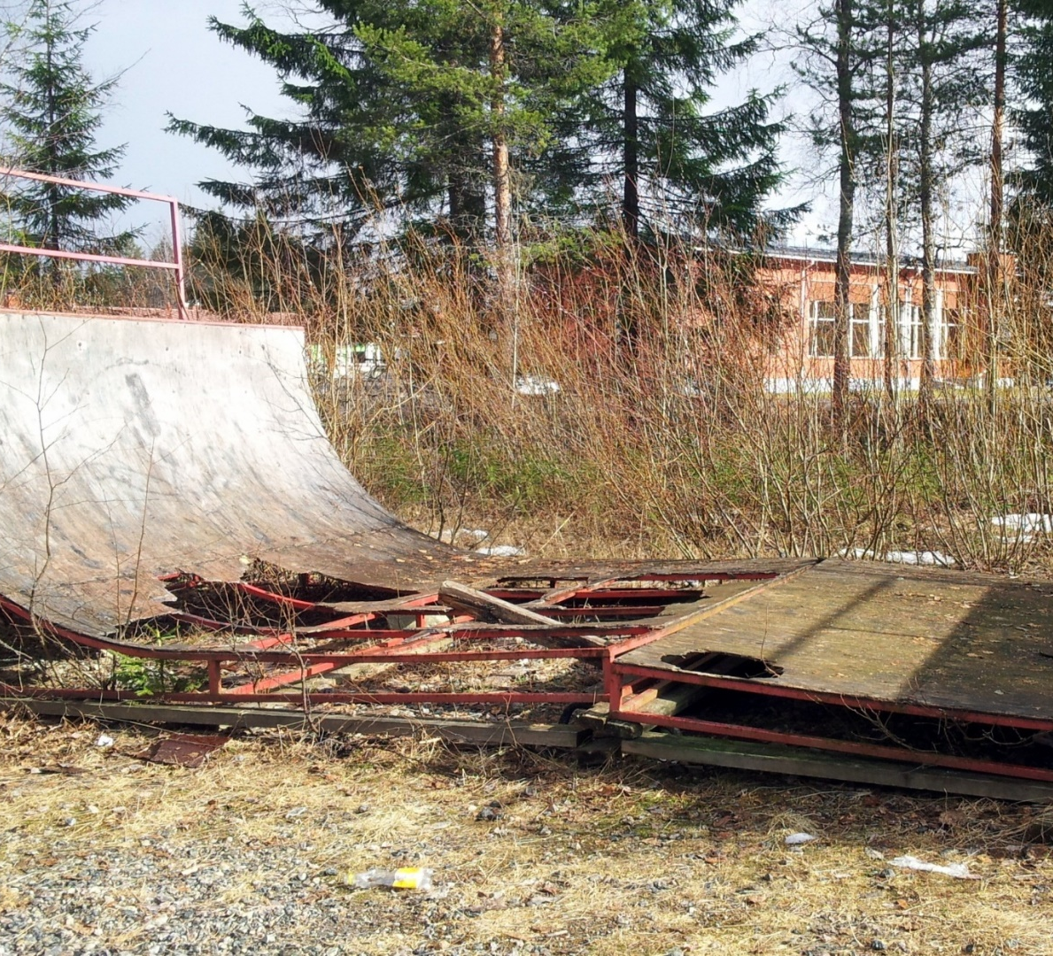
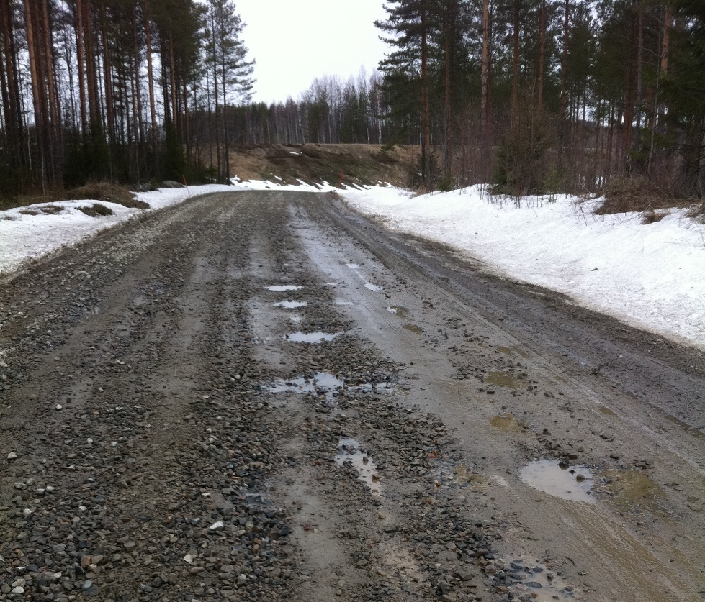
Eastern Finland
Population less than 1500
High school, with one class of approx. 20 students
Withering industrial town
Situated approx. 50 km from a bigger provincial town > disappearance of services
“Everyone knows each other”

Slide 12
Relationship to the rural home region is built over time and changes
Follow-up > more nuanced view on the process of staying / leaving
Out-migration in two waves:
After primary school for studies
After upper secondary for further education / job opportunities
Some have returned to home region after vocational studies – others may envision returning later
Multilocality characterizes the lives of most young people - also the ‘leavers’
Back-and-forth-movement, ’yo-yoing’ typical (Tagliabue et al., 2016) for emerging adulthood (Arnett 2000; 2011)
Contradictory relationship with the rural home region – both a source of strength and sorrow (see Vehkalahti, Aapola-Kari & Armila 2021; Vehkalahti, Armila & Sivenius 2021; Vehkalahti & Ristaniemi 2022)
Girls and women on a bus stop, 1964.
The Finnish Heritage Agency.

Slide 13
Availability of secondary education most decisive factor in young rural lives so far
HOX Young people from the rural research sites were the only, who had to make the choice of moving away from home in the age of 15-16
Eastern Finland
No secondary schooling available in town
All boys (7) chose vocational education (history as industrial site, traditional masculinities)
Girls both academic (6) & vocational tracks (5)
Commuting from home village, long distances & days
Many moved to provincial center right after primary schools (dormitories, shared flats with siblings, friends etc. )
Central Finland
Upper secondary school in the town
Some of the boys also chose the academic track! (3-6)
Girls both academic (5) & vocational tracks (4)
’Bying time’ by attending the local upper secondary school
Commuting not possible; those attending vocational studies had to move

Slide 14
Multilocality characterizes emerging adulthood in the rural region
M U L T I L O C A L I T Y
Determined to stay:
strong attachment to the rural place, people or lifestyles
Determined to move:
Gradual detachment from the rural place, people or lifestyles

Slide 15
1. Dedicated to stay
Feeling at home in rural communities socially, appreciation of local lifestyles
Consciousness of age-related expectations (e. g. education, gender norms, urban youth cultures) - Determination to go ’my way’
Criticism towards urban life - emphasis on the ´freedom´ or ’genuiness’ of countryside
Some denial of social problems addressed by other young people (e g. gender stereotypes, pressure of close communities)
Rural place & life depicted in terms of freedom and self-fulfilment
Strategic choices of education that enable employment (e. g. agriculture and forestry / service sector)

Slide 16
End of the 9th grade
Secondary studies (gymnasium) in the rural home town
’Year off’ , NEETs (e.g. medical leave, unemployment)
Secondary studies (vocational schools) in regional centers / other rural towns
Employment in home region
Employment in cities
Post secondary studies (e.g. universities of applied sciences, new vocational schools)
Military service
Summer jobs
Post secondary studies (e.g. higher education)
Urban
Rural
Laura
Parental leave

Slide 17
I’m going my own way
Young woman describing the social circles and her relationship with people in the rural homeplace:
Young woman: Well, there are those ‘amikset’ [nickname for young people studying in vocational schools]. For sure I’m ‘amis’ too, but I don’t count myself as such. [--] Then there are certain type of girls here… [laughs] I can’t explain how it is, but when you see them you get that feeling that you don’t want to hang out with them. Like irritating. [--] I don’t know if you can call them, not snobbish [hienohelmoja], but like those awful type of women who are like ‘Oh, I broke my nail, what do I do!?’ – that sort of girls.
Interviewer: Yes. Do you think there are different expectations for girls and boys here?
Young woman: Well, I don’t know… I think some people may expect different things. But I don’t know about that. [--] That kinds of things don’t play a role in my life. I’m not interested. I live here quietly with my cat, and other people may do whatever they want to! [laughs]
(Young woman, 19, recently moved back to her home village after vocational studies)

Slide 18
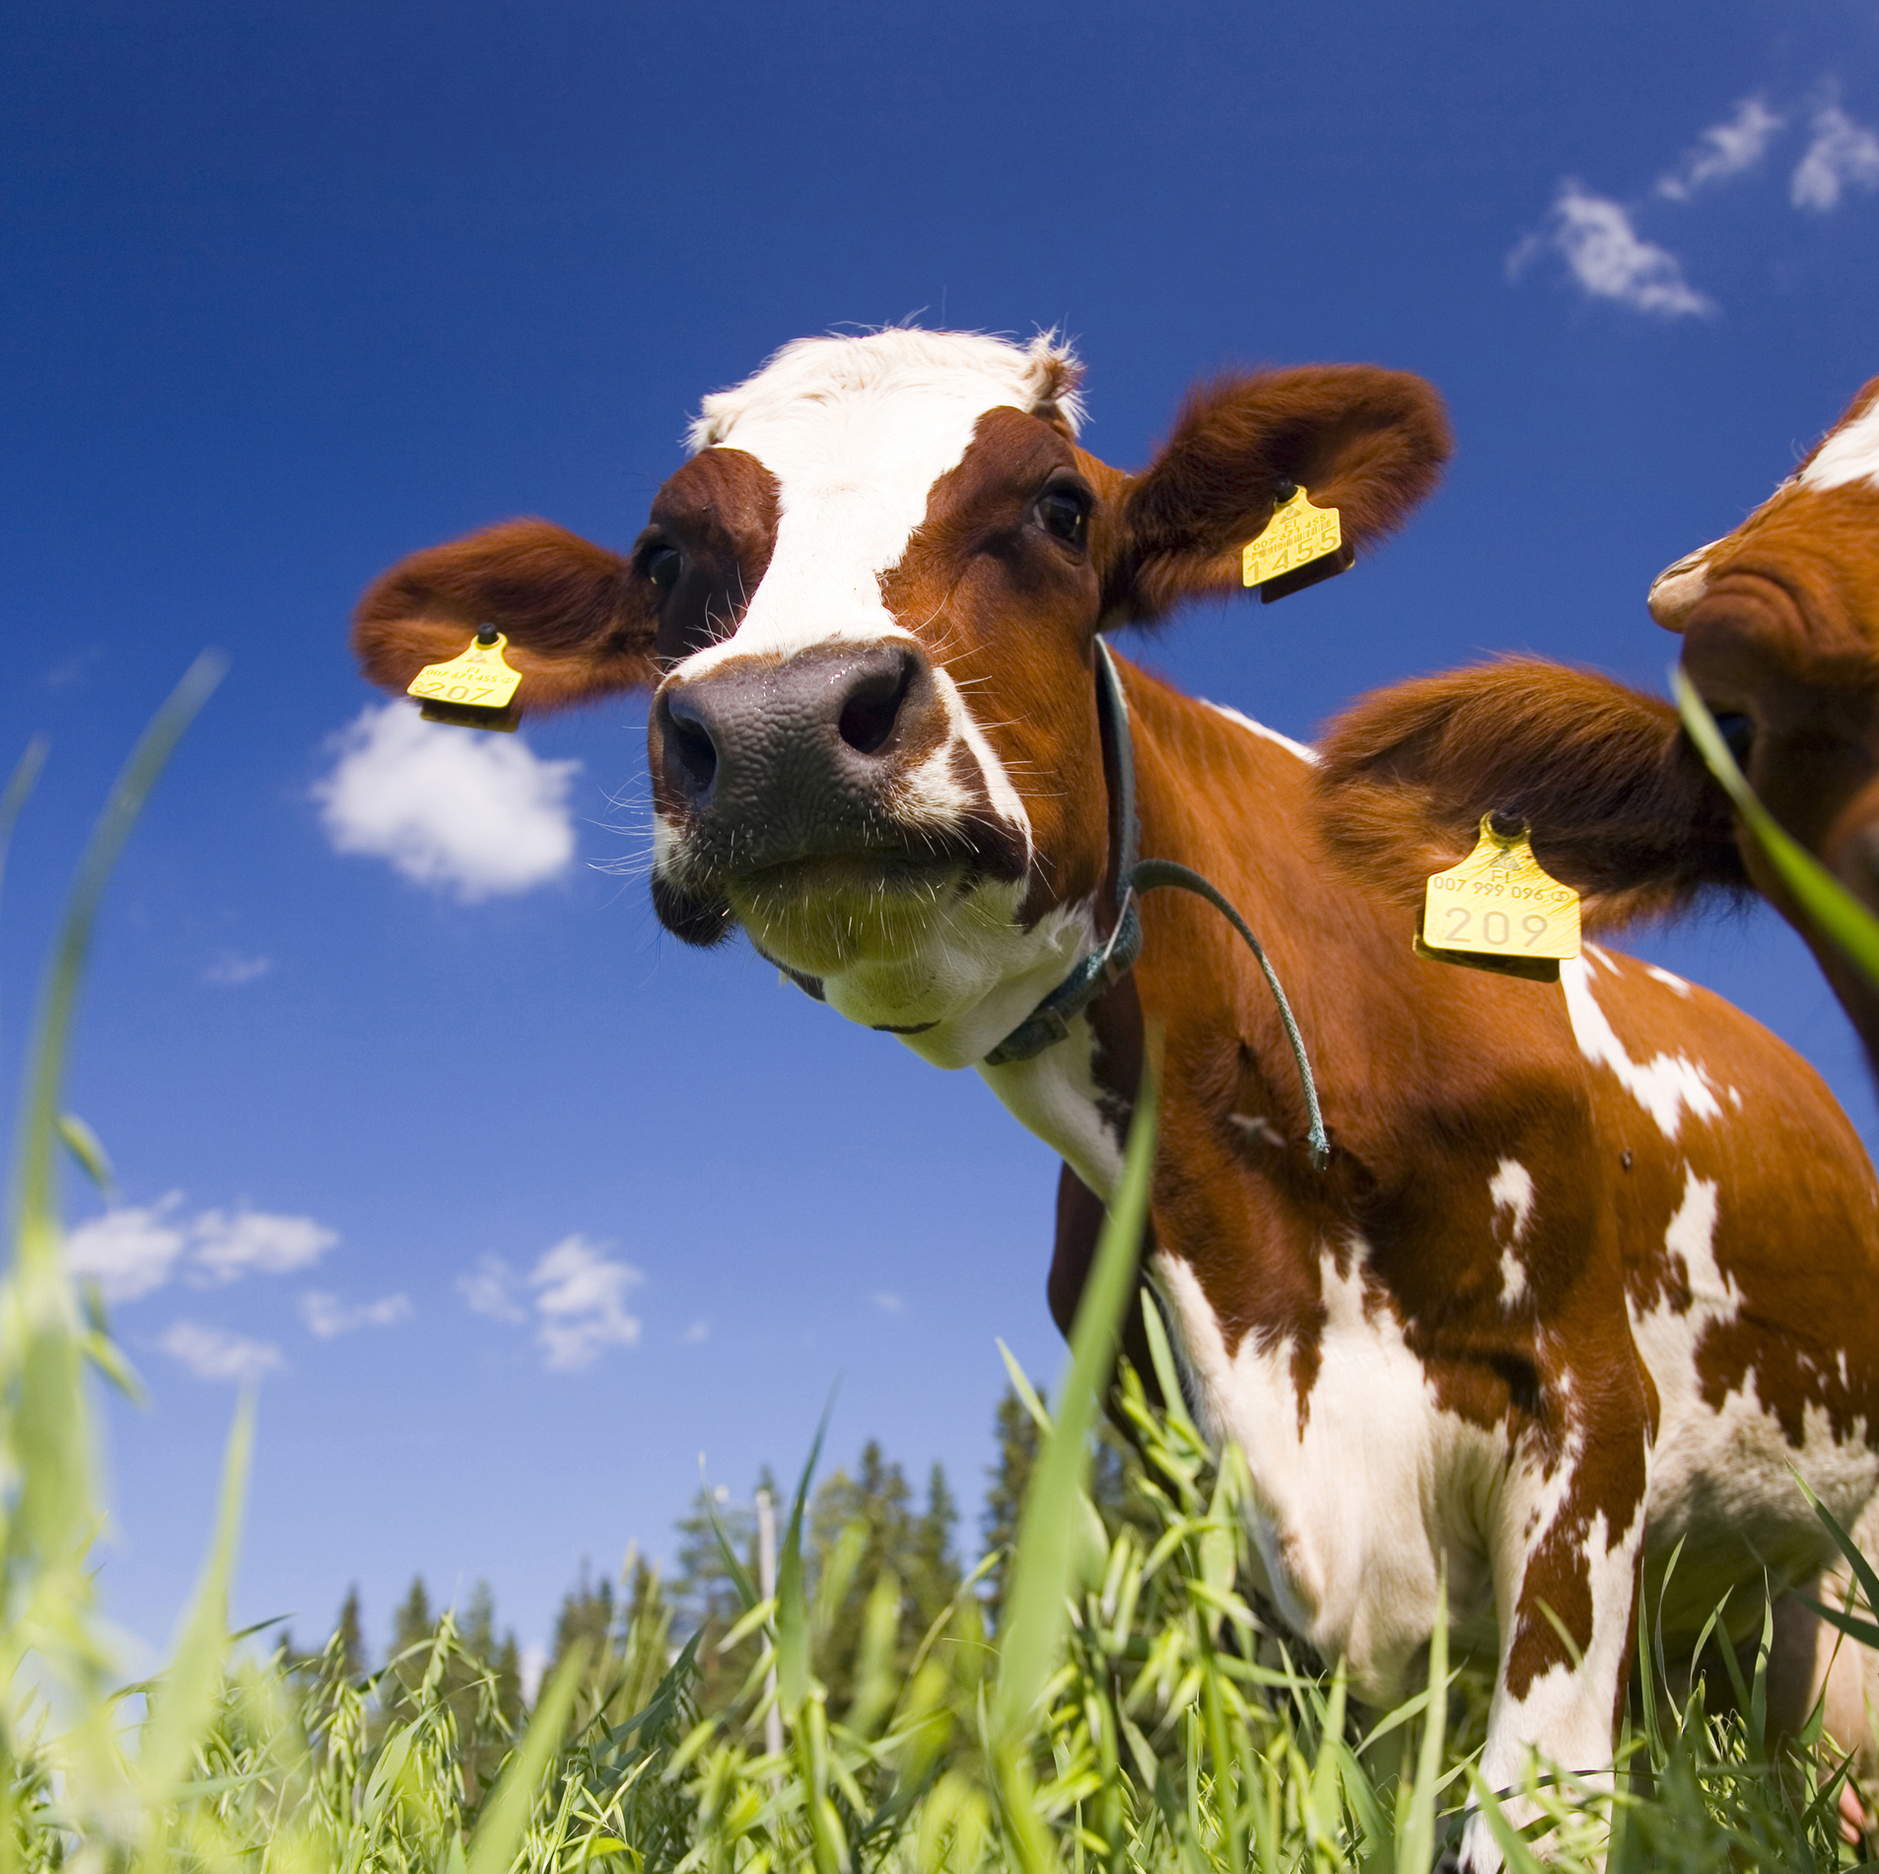
Narratives of self-fulfilment
Interviewer: Is it important for you to work with animals?
Laura: Yes it is. Of course there are always nasty individuals [laughs], but yes, to be with animals. Especially those big animals, cows in particular – I like!
They are so endearing. They are bit like big dogs… There [in her work place] are a few cows who come close to you if you walk by, they always want to be scratched and everything and for sure they are disarming.
And then it is great when you know you can have an impact on the well-being of these farmed animals, on the well-being of the cows, and you know that they actually do feel well, when you have been taking care of them your self. You know that they have everything well.
(Young woman, 22, employed in agriculture)

Slide 19
2. Multilocality in emerging adulthood
For most emerging rural adults it is too early to call whether they will be rural or urban
Continuous movement between rural & urban spaces due to education, work, family affairs etc.
New social circles, wider opportunities offered by city life – connection to the old social circles, family and ‘rural way of life’
Fusion of rural & urban e. g. presence of urban youth cultures in the rural settings, digital communication

Slide 20
End of the 9th grade
Secondary studies (gymnasium) in the rural home town
’Year off’ , NEETs (e.g. medical leave, unemployment)
Secondary studies (vocational schools) in a bigger rural town
Employment in home region
Unemployment in city
Post secondary studies (vocational schools)
Military service
Summer jobs
Higher education (university of applied sciences)
Urban
Rural
Veeti
Parental leave

Slide 21
Negotiating rural and urban spheres, mindsets
[Interviewed about what childhood & youth in a small country-side town has taught him]
Veeti: Oh yes. I believe that if I had grown up in a city, I wouldn’t have manual skills like I do now [ability repair motors, cars, etc], for example, and my view on life might be different as well. Things would look different from the perspective of a city dweller.
Interviewer: How do you mean different?
Veeti: For example, when I’ve been to student parties here, I have noticed that you shouldn’t neccessarily open your mouth when some people talk about politics. When you have a countryman’s perspective to things like private car use and fuel prices – which have been debated a lot recently – your opinions are so different from those who have come here to study from Helsinki. In those cases I haven’t bothered to open my mouth, for it would be like, someone’s night would be ruined. [with a laugh] Because you see some political issues, like driving, so differently.
(Young man 21, studies at a university of advanced sciences)

Slide 22
Criticism towards urban spaces, lifestyles
Interviewer: How about in the future, in what kind of surroundings would you like to live?
Matias: I can’t see my self living in any big city. That’s just not my thing. That place where I used to live here first [in the new city where he studies], it looked like some Soviet blocks of flats. Where there are masses of student appartments in the same blocks of flats. But now we live here close to the airport in an area of single-family houses [omakotitaloalue]. There are just five houses on this street, which is nice. Of course, the distance to my workplace is now about 8 km, but I prefer that to living in the centre. It is even cheaper to live here.
(Young man 22, interviewed during studies in a university of applied sciences)

Slide 23
Bridging the divide with strategic choices
Strategic choices of education (e. g. vocational studies related to agriculture and forestry / service sector) that enable employment in the wider regional labour market
Recidential choices that enable the maintenance of rural lifestyles ( e. g. rural hobbies like cars, animals)
Appreciation of life styles and values understood as rural

Slide 24
Analysis of lifepaths in emerging rural adulthood
End of the 9th grade
Secondary studies (gymnasium) in the rural home town
’Year off’ , NEETs (e.g. medical leave, unemployment)
Secondary studies (vocational schools) in regional centers / other rural towns
Employment in home region
Employment in cities
Post secondary studies (e.g. universities of applied sciences, new vocational schools)
Military service
Summer jobs
Post secondary studies (e.g. higher education)
Urban
Rural
Antti
Parental leave

Slide 25
Strategic choices
Young man: It never harms you to further educate your self. To get a bit higher position in the working life. [talks about nerby possibilities in universities of higher education]
We [me and my girlfriend] have been planning to move to [nearby bigger, but still rural town] after my military service. In practice we’ll have the same distance to our working places, a bit longer for me, but not much. There would be a bit more services available and we could find our own garage to hire [for a hobby including cars] - -
Interviewer: If you could choose freely, where would you like to live in the future?
Young man: Well, it would be like a place closer to a bit bigger town. Kind of like a village. At maximum 15 km to the center, but you could live in your own peace anyway, there wouldn’t be neighbours too close, a large plot of land, preferably close to a lake – that would be nice.
Interviewer: Yes. Like a small piece of [your home village]
Young man: Yes. Yes, yes.
(Young man 19, permanently emplyed after vocational school)

Slide 26
Building urban lives – staying anchored in the rural milieu
Future is seen elsewhere!
Strategic choices do not support plans of returning (e.g. higher education)
Appreciation of countryside as a safe childhood milieu
Rural home place as a place to ‘cool down’, to ‘load your batteries’, ‘to relax’
Long time summer jobs in the area
Conflicting emotions

Slide 27
Analysis of lifepaths in emerging rural adulthood
Secondary studies (gymnasium) in the rural home town
’Year off’ , NEETs (e.g. medical leave, unemployment)
Secondary studies (vocational schools) in regional centers / other rural towns
Employment in home region
Employment in cities
Post secondary studies (vocational schools)
Military service
Summer jobs
Higher education (university)
End of the 9th grade
Urban
Rural
Aino

Slide 28
Rural place as a source of strength
[Interviewer asks if she has felt lonely during the Covid-19 restrictions]
Aino: Well, actually I have! I was surprised because I normally never feel lonely, for I have such a wide circle of friends [- -] At some point I felt that – oh my god – I can’t, I can’t keep up just studying [alone at home], this is so boring and there’s nothing going on.
Then I called my mom, and she was like: ‘All right now, come here. Now it sounds like you need company. Pack up your stuff and come over here. You can stay a few weeks, or as long as you like and can with your studies.’ It has always been like this that I can go home whenever I want, I mean there, to my home-home [kotikotiin], I’m always welcome – and that’s what I did and it was a relief for me at the time [--].
(Girl 22, telling about Covid-19 experiences during her university studies)

Slide 29
Rural place as a soothing place where to return
Aleksi: I thought that if I stay there in the city all by my self I will get depressed and all my life will go up-side-down, and so I thought that okay, let’s go back to [home town] for a while. I decided to resign from my work and that was that [laughs]
Interviewer: How did you like living in a city?
Aleksi: It was awesome! [- -]
I figured that if I continue like this, my chances to study for entrance exams are getting poorer and poorer, like chances to go to gym, other hobbies etc. So I thought that let’s take a break to relax here in the old neighbourhood - in a therapeutic sense, reload and then move on to new sceneries. [--]
I felt that it [to continue living in the city] might have lead to a situation where I wouldn’t have been in a very strong state of mind mentally. It’s good that I have these so called supporting pillars of my life here, brothers, parents, all these [--]
(Young man 22, interviewed after break-up and return to home village from a bigger city)

Slide 30
3. Detachment from the rural place
Gradual detachment / break with ‘old life’ during the high school years, which is now seen as poor – sometimes even harmful
Growing criticism towards the rural area:
General development of the area, lack of employment, opportunities, ‘smallness’
Gender roles (e.g. gossiping)
Old dated and rigid ways of thinking (e.g. about multiculturalism)
Rural life styles, like heavy alcohol consumption
However, that place still remains important!
History, memory, transgenerational transfer

Slide 31
Analysis of lifepaths in emerging rural adulthood
End of the 9th grade
Secondary studies (gymnasium) in the rural home town
’Year off’ , NEETs (e.g. medical leave, unemployment)
Secondary studies (double-degree) in a provinciall center
Employment in home region
Employment in cities
Post secondary studies (vocational schools)
Military service
Summer jobs
Higher education
Urban
Rural
Venla

Slide 32
Gradual detachment from the rural place, which still remains dear, split emotions
I’m always looking forward to coming here for the weekend, but then when I’m here, I’m like, “Why did I come here?” or like. I don’t see myself here anymore. I enjoy being here so much, and this is an important place for me, but I feel that there is just nothing for me anymore. This is so withered as a place. My family is here, and I have friends too, but I have a feeling that I never meet them anymore. You start to feel like you should just have stayed there [in the city]. .
(Girl 17, interview after first year of studies in the provincial center)

Slide 33
Closeness with family – alienation from rural life
Interviewer: Where is your home, is it here or there [in the home town]?
Venla: My home is here in the city, and that [rural childhood home] is my home-home [kotikoti] [laughs], that’s what I always say, it’s my home-home and this is my home. It took me a long time after moving here to to call my own place a home, it was just a place to stay for a long time [kämppä], so I said I’m just going to my place, but now it has become my home.
[Talks about closeness to her family in the rural village]
Venla: Life there is so different, so different, I don’t miss that at all. I have said that those people that are of my age and live there, I wouldn’t know how to hang around with them anymore, because it’s so different and I don’t miss that in my life. [--]
All you do there is drinking beer and driving around, and fixing cars at some garage – and playing music so loud that you don’t hear anything [laughs]
(Young woman 22, in working life, interviewed after 6 years of living in a city)

Slide 34
Conclusion
Who are rural – who are urban?
Education & career -related factors central – but there is a wide variety of other factros too!
Rural youth migration rather a process than a stright-forward decision
How to see beyond the obvious gender bias? Girls choosing to stay more concsiously ’going against the grain’, ned to explain their choices
Young adulthood characterized by multilocality, strengthened by Covid-19
Rural home regions continue to be relevant and meaningful even for those young people, who are critical / move away – translocal identities (Appadurai 1996)

Slide 35
Belonging in the rural?
Application of multiple strategies to stay connected:
to settle in rural settings
to split time between rural and urban settings
to introduce rural elements in urban lives
Many envision a future of combining the best qualities in rural & urban life – either in the home region, or close to nature in cities
Ability to fulfill one’s dreams, freedom strong motivation for building an adult life in rural settings
Contradictory emotions: strong feelings of belonging in some aspects of rural life – alienation from others
Transgenerational, historic bonds to family, places, traditions, ways of living

Slide 36
Aitäh!
Academy Reseach Fellow
Kaisa Vehkalahti
History & Ethnology, University of Jyväskylä
kaisa.r.vehkalahti@jyu.fi
@VehkalahtiKaisa

Slide 37
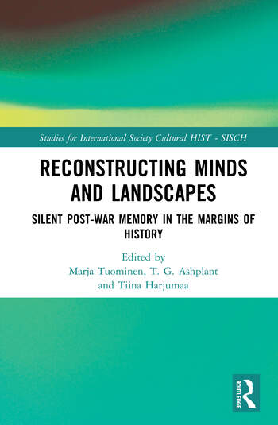
Results
Journal of Youth Studies Special Issue: Youth, Rural Places and Marginalisation (forthcoming 2023).
Vehkalahti & Ristaniemi (2022) Places of Belonging, Places of Detachment: Belonging and Historical Consciousness in Narratives of Rural Finnish Girls. In Youth Beyond the City. Thinking from the Margins. Ed. by. Farrugia & Ravn. Bristol University Press.
Vehkalahti, Armila & Aapola-Kari (toim. 2021) Sata nuorta - sata polkua aikuisuuteen. Laadullinen seurantatutkimus Nuoret ajassa. NTS: Helsinki.
Vehkalahti, Armila & Sivenius (2021) Emerging Adulthood in the Time of Pandemic. The Covid-19 Crisis in the Lives of Rural Young Adults in Finland. Young - Nordic Journal of Youth Studies vol 29 (4), 399-416.
Jouhki & Vehkalahti (2020) Reconstructed Landscapes of Northern Youth: Reading the Autobiographies of Finnish Youth, 1945-1960. In Reconstructing Minds and Landscapes. Silent Post-War Memory in the Margins of History. Ed. by Tuominen, Ashplant & Harjumaa. Routledge: New York-London.
Aapola-Kari & Vehkalahti (2020) Jatkuvuutta, resursseja ja neuvottelua: nuoret puhuvat perheestä. Nuorten perhe- ja läheissuhteet sekä seksuaalisuus. Nuorten elinolot -vuosikirja 2020. Toim. Valkendorff & Sihvonen. THL, Helsinki.

