Slide 1


Enabling enthusiasts to become ambassadors of your research
Mikelis Grivins, dr.soc.
professor at Riga Stradins University,
senior researcher at Baltic Studies Centre
mail: mikelis.grivins@rsu.lv

Slide 2
About me
Professor at Riga Stradins University and senior researcher at Baltic Studies Centre.
For the last ten years or so I have been working with agro-food systems.

Slide 3

The focus of this story
Since 2020, we have been working to build a pan-European network of 40 food activists;
In the years of its existence the network has been used to share cutting-edge research results, to test research results and - it has spawned six new food-related initiatives.

Slide 4


Case study
In the year 2020 one of our project H2020 proposals titled COCOREADO was funded. It was a CSA project aimed at using research results to facilitate change in the food systems:
To make the systems more sustainable;
To improve farmers' position within the supply chain.
There is a huge difference between communication and achieving, that somebody uses the results of your study. We were striving for the second.

Slide 5
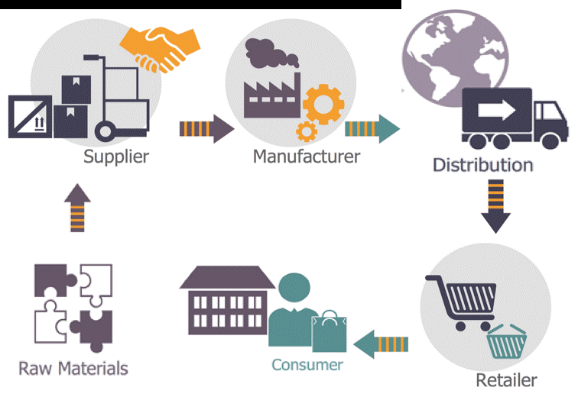
The challenge of food-related change is that we have to think about the change in terms of “systems”. This means that there is a large network of interlinked actors being affected by any change taking place.

Slide 6

The perspective
Size of systems
We cannot simultane-ously communicate with all actors holding stakes in the food systems.
Difficulties to reach
Even if we will try, a large share of stakeholders will not listen to us or will not believe us.
Various needs
From afar, we do not fully grasp the needs, interests and problems of local stakeholders.
Openess
We will not have resources to convince those, opposing change.

Slide 7

We envisioned a network of people passionate about food and interested in change.
Our task would be to prepare and support the attempts of this group to communicate.
To do this we established a training program for food ambassadors.

Slide 8
Challenges of the approach (1)
1.
Finding the right people
2.
Engaging all system
3.
Develop interest/ trust
4.
Maintain interest/ trust
5.
Provide the right insights
Using the existing structures to communicate our needs
Developing an appealing proposal
Focusing on the real problems. Being transparent.
Giving your best in developing the program. Listening to ambassadors.
Develop feedback channels. Change when things are not working.

Slide 9
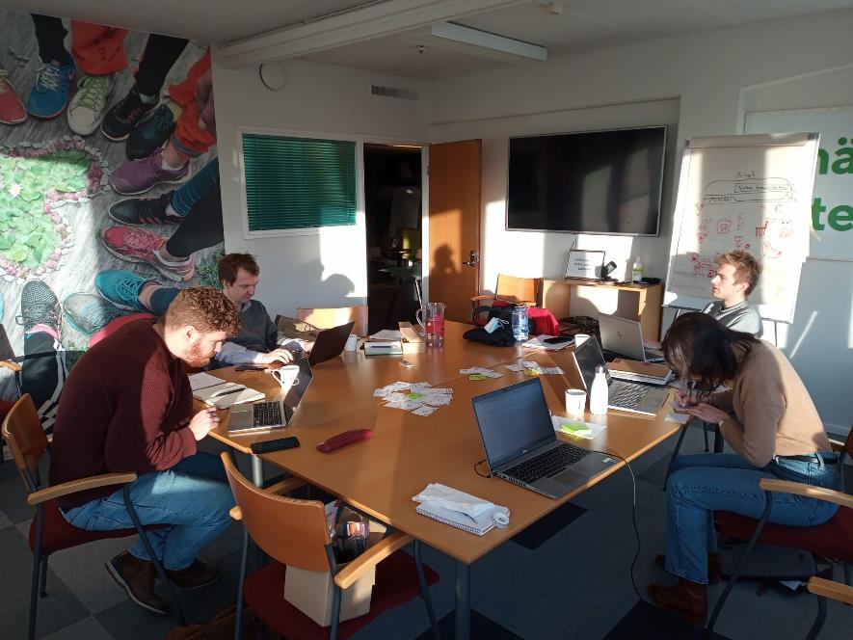
Challenges of the approach (2)
No matter how good you are, you cannot develop a network and a training program on your own. You need partners who also feel responsible for the final result!
One creates this shared responsibility by being open and transparent at all steps, assigning roles to partners, asking for their advice, and showing the benefits of the developed solution.

Slide 10
So how we did it?

Slide 11
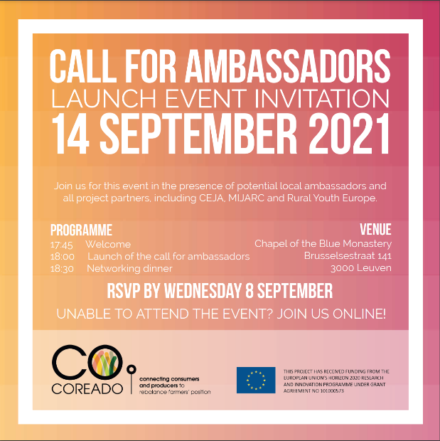
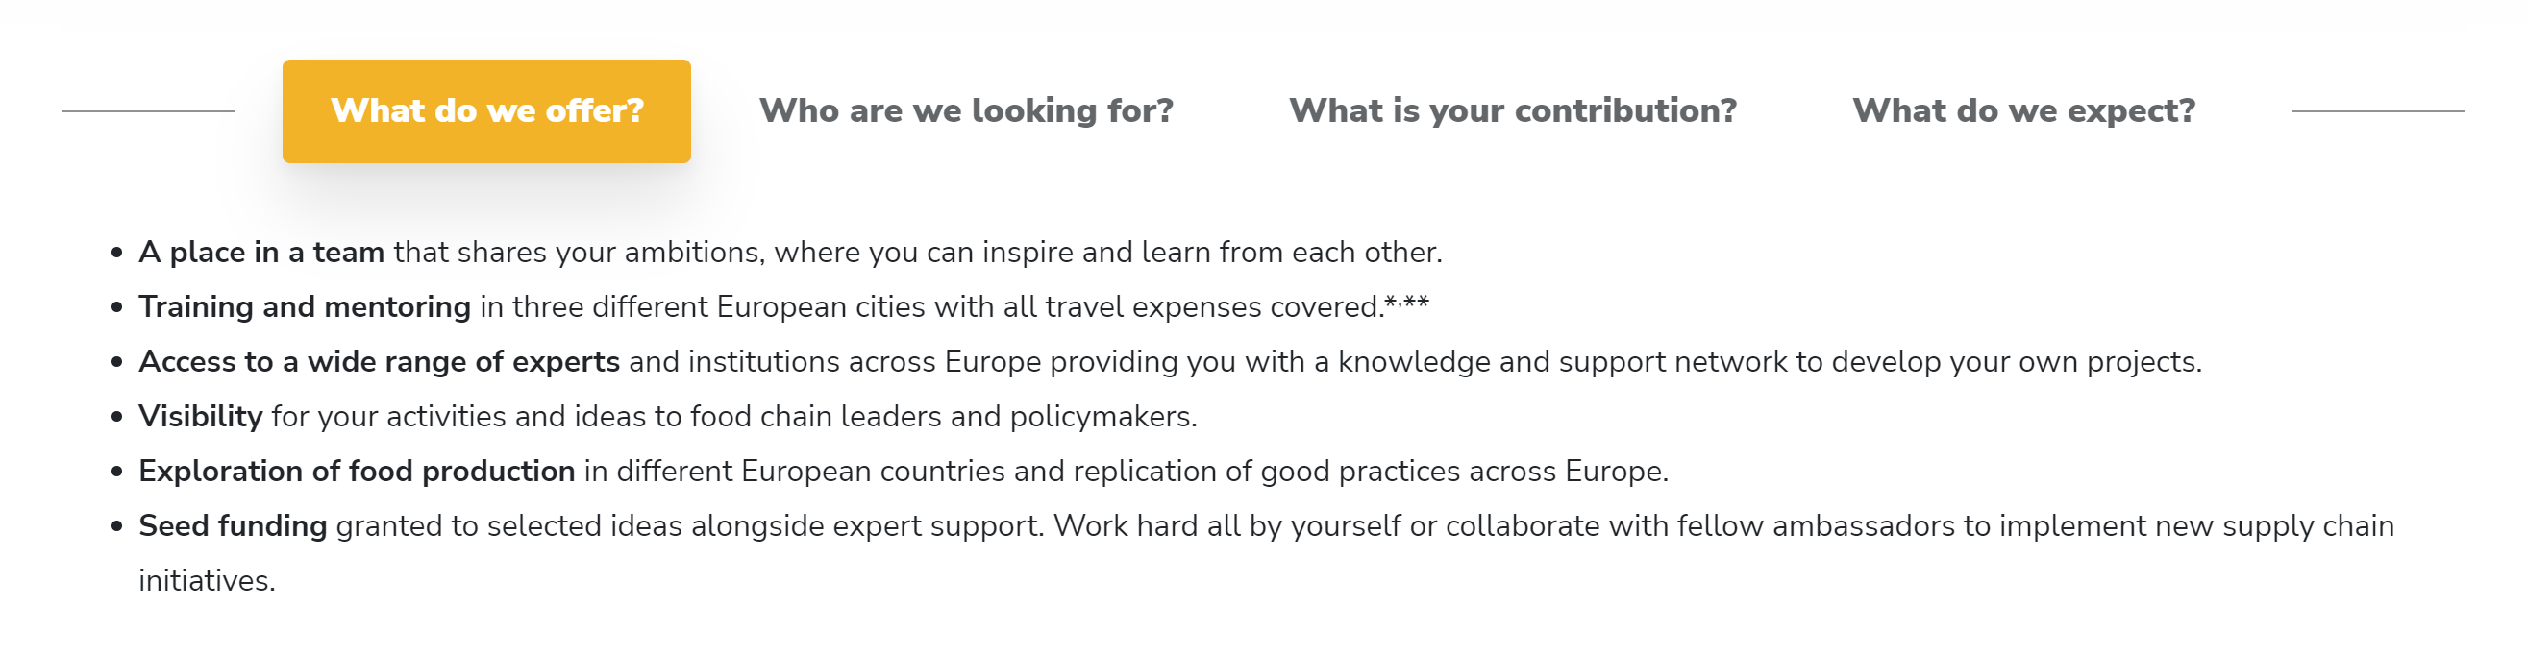
The call for ambassadors

Slide 12
Profile of the network
Applicants
1st training
2nd training
AGE:
GENDER:

Slide 13

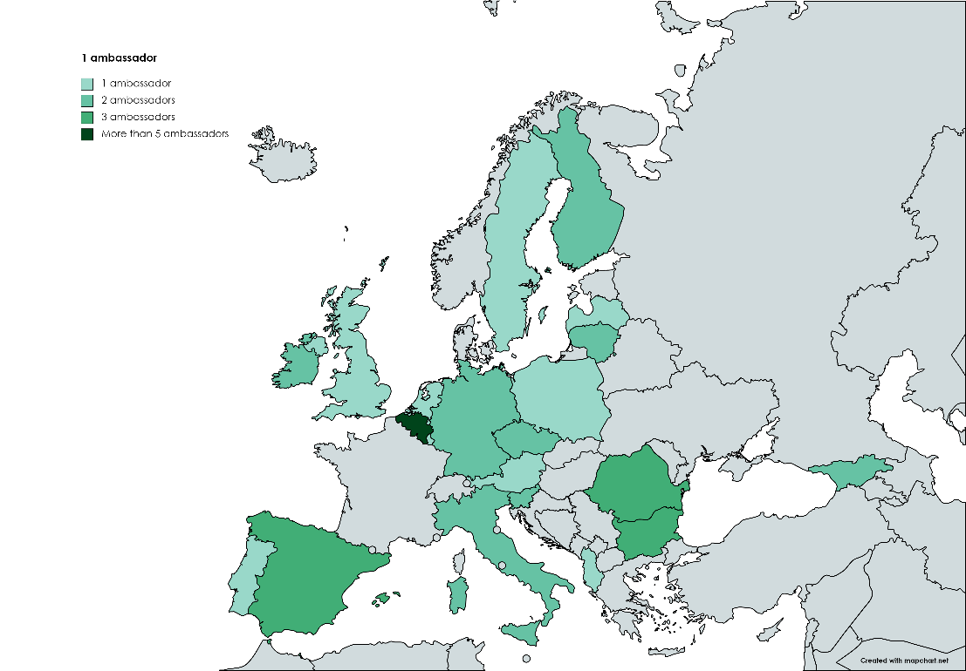
The second training
34 ambassadors were participating in the training;
3 ambassadors left the network (two of them were not present in the first training);
7 ambassadors were not able to attend;
4 ambassadors have been recommended by the people, who were not able to attend.

Slide 14
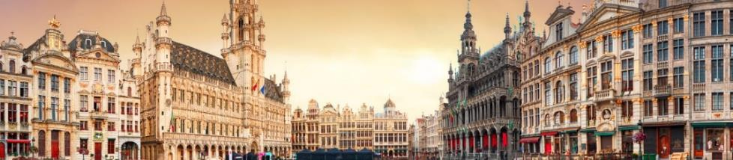
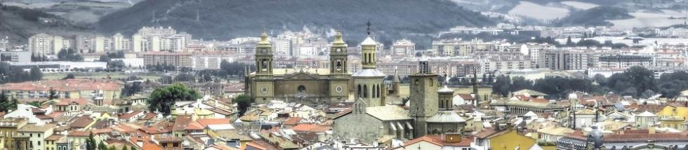
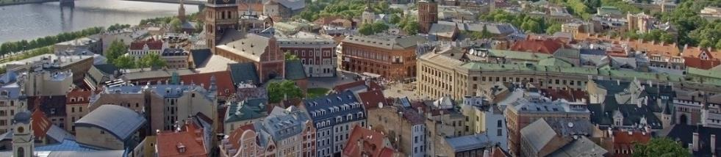
Maintaining interest
Brussels (Belgium)
The first ambassadors training
March 28-30, 2022
Pamplona (Spain)
The second ambassadors training
October 10-12, 2022
Riga (Latvia)
The third ambassadors training
May 8-10, 2023

Slide 15
Monitoring interests
Networking
To create links between people attending (ambassadors, project partners, anybody else who might be joining) and to create a possibility to network with people living here – in Pamplona.
Excursions
To engage in local food fair and get inspired by the local foodscape.
Co-creation
Discussions and assess the novel food initiatives from across Europe. Co-creation of potential seed-initiatives.
Training
To provide a space, tools and mentorship to help you think about challenges that are close to your heart.

Slide 16
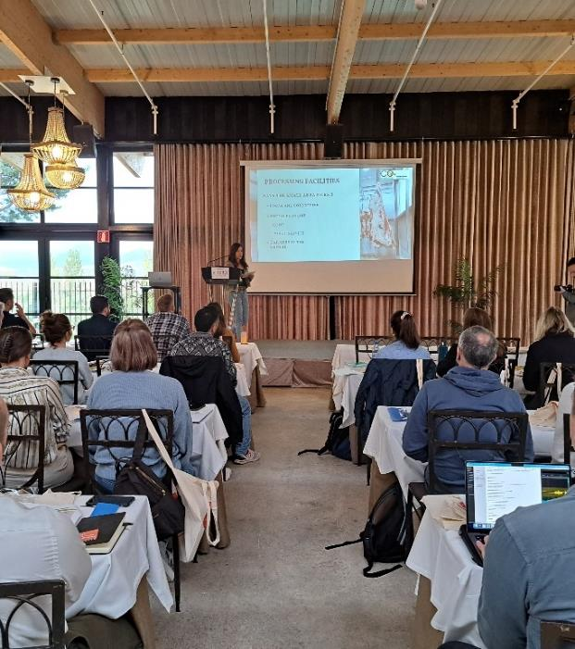
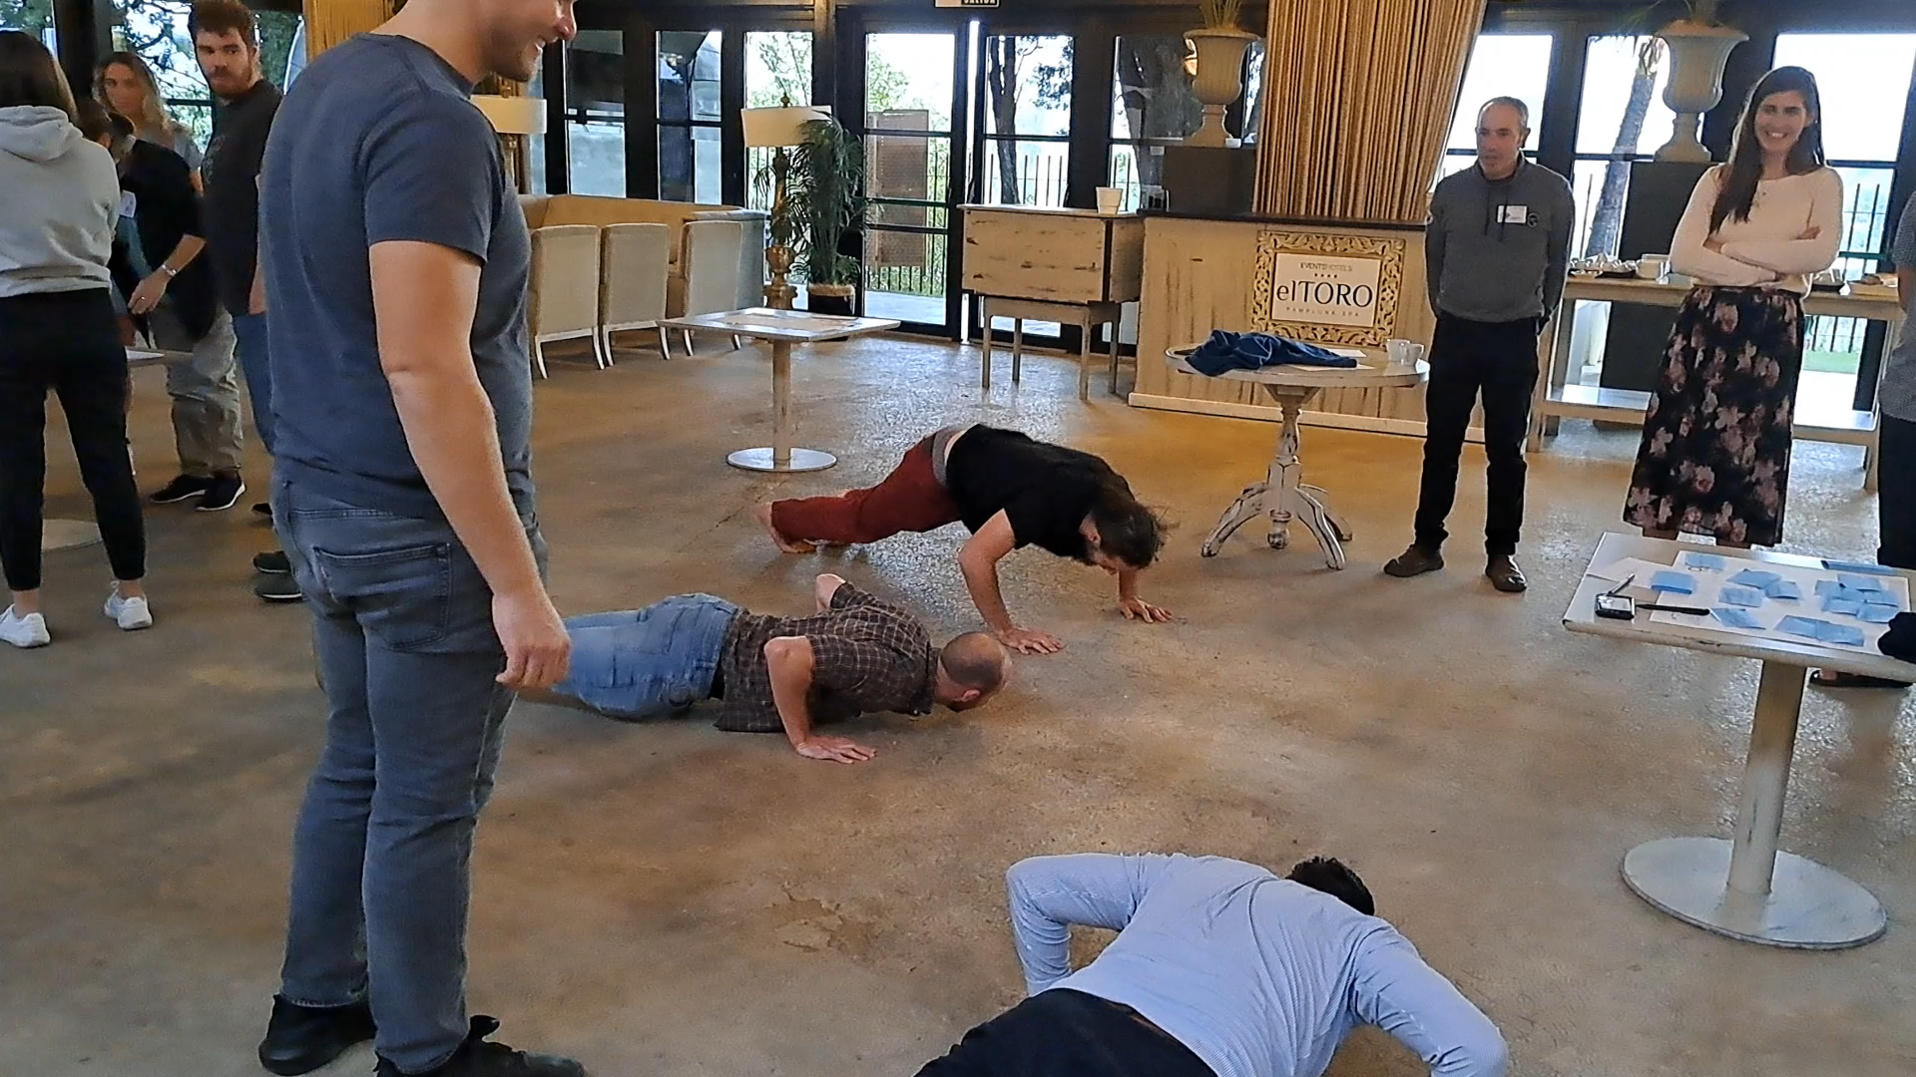
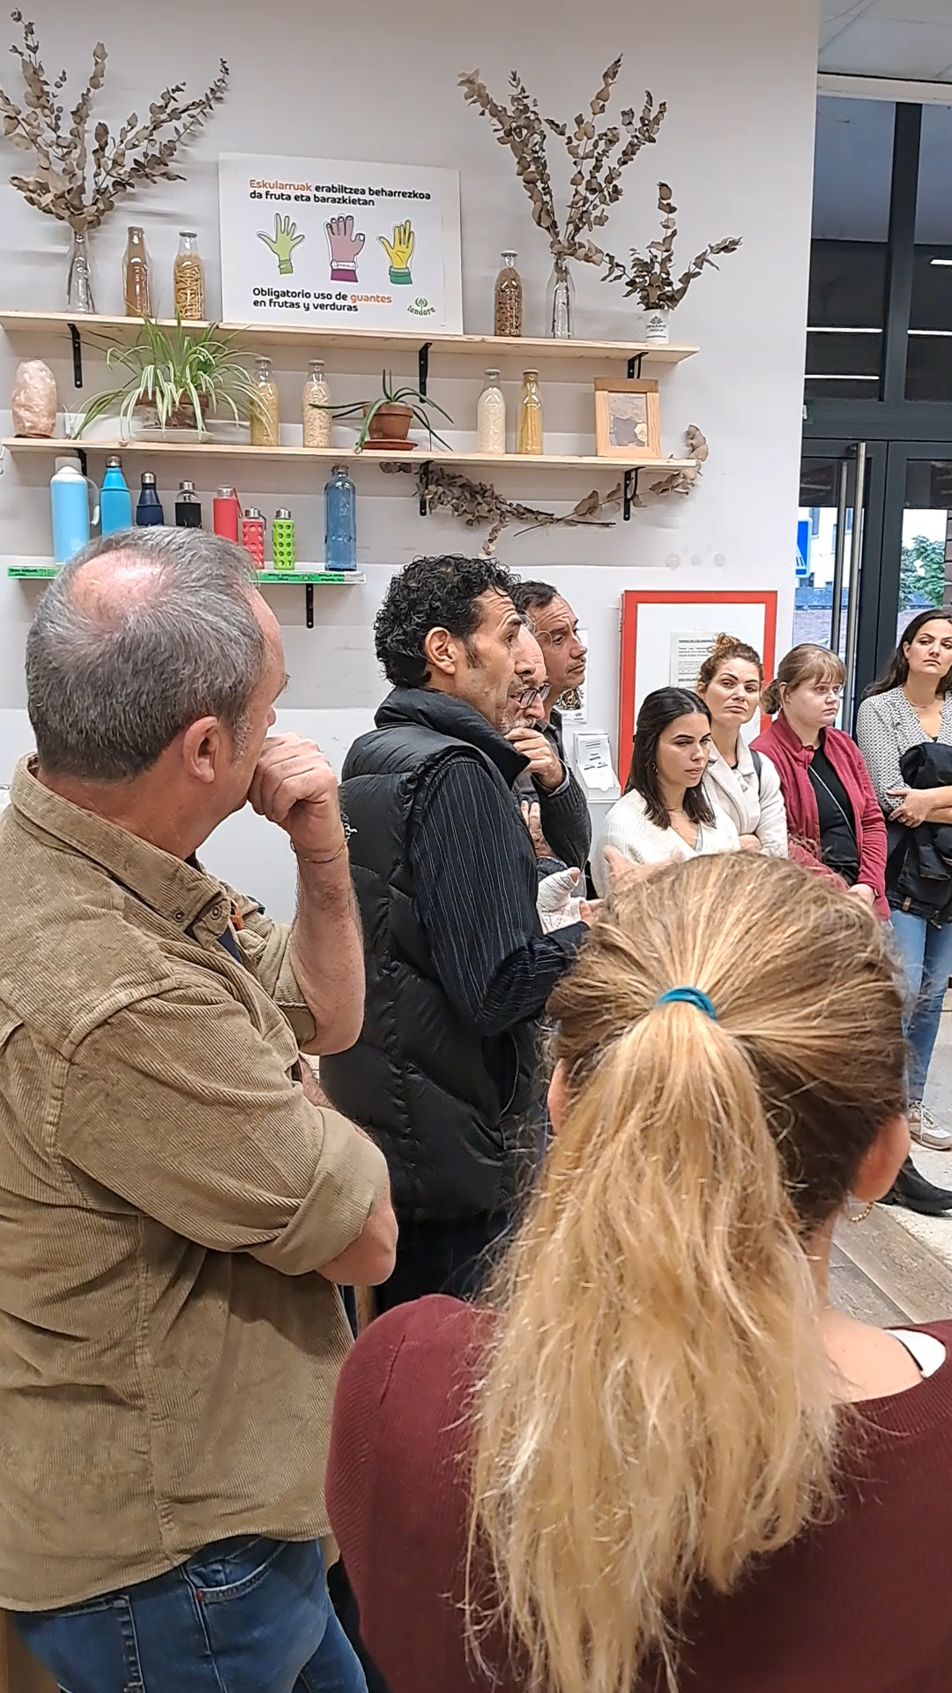
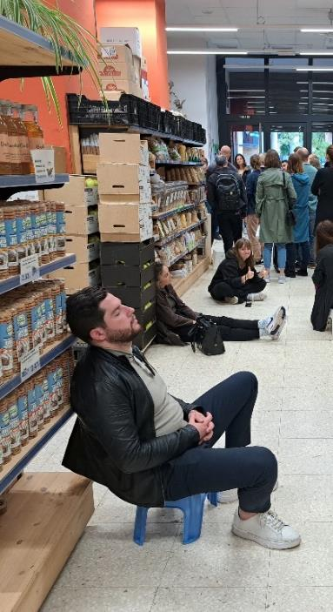
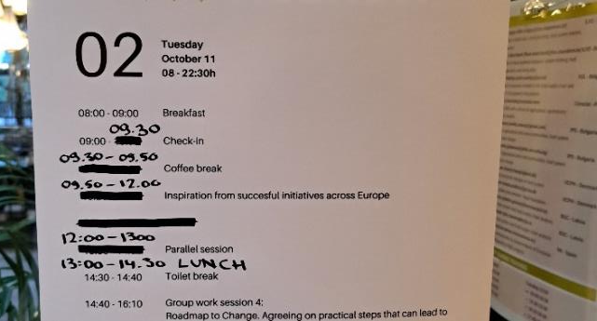
Day 1
Day 2
Day 3

Slide 17
Monitoring satisfaction
The data
Pre-training survey – conducted online from Jan 28 till Feb 9. 22 filled questionnaires collected.
Post 1st training – conducted in person on March 30. 25 filled questionnaires collected.
Post 2nd training – conducted online from Oct 20 till Oct 26. 19 filled questionnaires collected.

Slide 18
 | 1st training (avg) | 2nd training (avg)
How satisfied are you with the organisation of the training? | 8.0 | 7.8
How satisfied are you with the training itself? | 7.6 | 8.1
how satisfied are you with the outcomes of the trainings? | 7.8 | 8.1
Comments after the 1st training:
«dynamic between ambassadors was good! next time we should allign the sessions more»
«After planning and discussing a lot about the 1st training, we brought an interesting group together and have a lot of opportunities there.»
«Strengths - networking, project objectives achieved. Shortcomings - more involvement of the consortium partners with the ambassadors»
Comments after the 2nd training:
«It was a well-planned program and you could really tell that there was an overall idea behind it…»
«The main strenghts are the script and agenda, which allow everyone to be able to know what was taking place…»
«Shortcomings: too many group works and few frontal lectures»
«Not all partners were involved in the development of the training and the script»

Slide 19

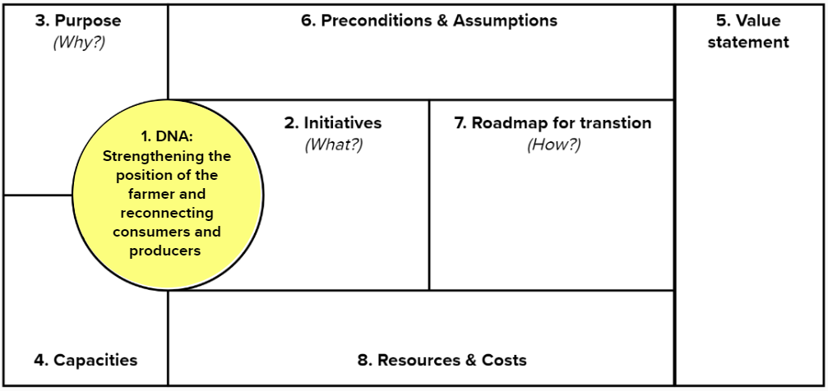
Providing tools
+

Slide 20

Why we have been successful in what we do?
Strong group of international partners
Reflecting on what we are doing and how we are doing it
Willingness to listen and learn from our mistakes
Allocating money for this activity

Slide 21
Thank you!
Mikelis Grivins, dr.soc.
professor at Riga Stradins University,
senior researcher at Baltic Studies Centre
mail: mikelis.grivins@rsu.lv

